Slide 1





applied data science
ARUL SELVAN
VVCET

Slide 2






T A B L E O F C O N T E N T
1 . P R O B L E M S T A T M E N T ,
2 . D E S I G N T H I N K I N G
P R O C E S S ,
. P H A S E O F D E V E L O P M E N T ,
. D A T A
S E T ,
5 . D A T A P R E P R O C E S S I N G
S T E P S ,
T E C H N I Q U E S ,
6 . F E A T U R E
E X T R A T I O N
7 . M O D E L T R A I N I N G ,
8 . E V A L U A T I O N
M E T R I C S ,
9 . C O N C L U C T I O N

Slide 3




PROBLEM STATMENT
The problem is to build a predictive model that forecasts stock prices based on historical market data. The goal is to create a tool that assists investors in making well-informed decisions and optimizing their investment strategies. This project involves data collection, data preprocessing, feature engineering, model selection, training, and evaluation.

Slide 4



DESIGN THINKING PROCESS
Data Collection:
Gather historical stock market data from reliable sources.
Data Preprocessing:
Clean and prepare the data. Handle missing values, outliers, and ensure data consistency.
Feature Engineering:
Create relevant features from the raw data. This could involve calculating technical.
Model Selection:
Choose appropriate machine learning or deep learning models for prediction.

Slide 5


Evaluation:
Evaluate your model(s) using appropriate metrics such as Mean Absolute Error (MAE), Mean Squared Error (MSE), or others.
Training:
Split the data into training and testing sets. Train your chosen model(s) on the training data. You may need to experiment with hyper parameters to optimize model performance.
Deployment:
Once satisfied with your model's performance, deploy it as a tool for investors. This could be a web application, API, or any other interface that provides forecasts and insights.
Continuous Monitoring:
Continuously update your model with new data to ensure it remains accurate. Markets can change rapidly, and your model should adapt accordingly.

Slide 6


PHASE OF DEVELOPMENT
1.)Problem Definition and Objective Setting:
Clearly define the scope and objectives of your stock price prediction model.Are you interested in short-term or long-term predictions? Whstocks or markets are you targeting? What metrics will you use to evaluate the model's performance (e.g., RMSE, MAE, or Sharpe ratio for investment strategies
2.)Data Collection:
Collect historical market data for the stocks or assets you want to predict. This data typically includes daily or intraday stock prices, trading volumes, and any other relevant financial or economic indicators.
3.)Data Preprocessing:
Clean the data by addressing missing values, outliers, and data discrepancies. This phase might also include data normalization and dealing with irregularities in the time series data.
4.)Feature Engineering:
Create relevant features that can help the model learn patterns and trends in the stock data. Features can include technical indicators (e.g., moving averages, MACD), fundamental data (e.g., earnings, P/E ratios), and sentiment analysis from news or social media.

Slide 7

5.)Data Splitting:
Split the data into training, validation, and test sets. For time series data, this should be done sequentially to mimic real-world forecasting scenarios.
6.)Model Selection:
Choose appropriate models for stock price prediction. Options include time series models (e.g., ARIMA, GARCH), machine learning models (e.g., regression, decision trees, random forests), and deep learning models (e.g., recurrent neural networks, LSTM, or GRU).
7.)Model Training:
Train the selected model on the training data.
Hyperparameter tuning may be necessary to optimize model performance.
8.)Model Evaluation:
Assess the model's performance on the validation set using appropriate metrics (e.g., Mean Absolute Error, Mean Squared Error, or custom financial metrics).

Slide 8
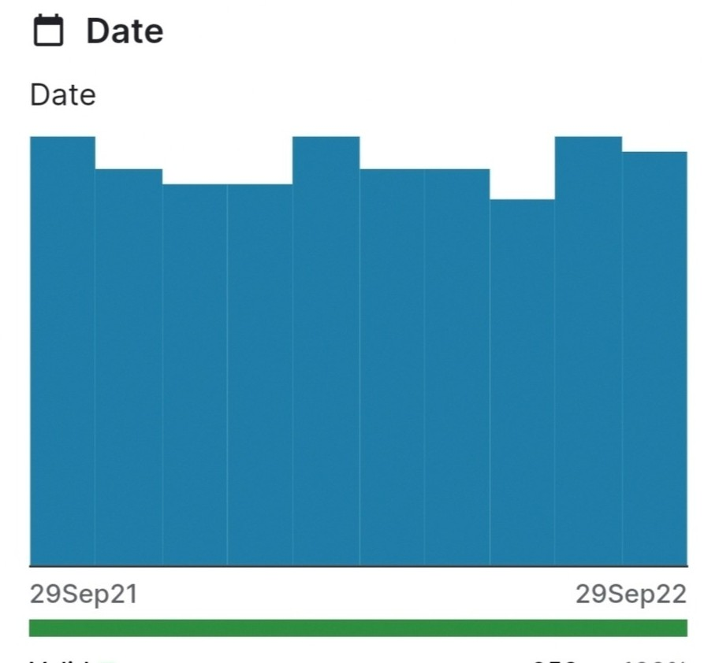
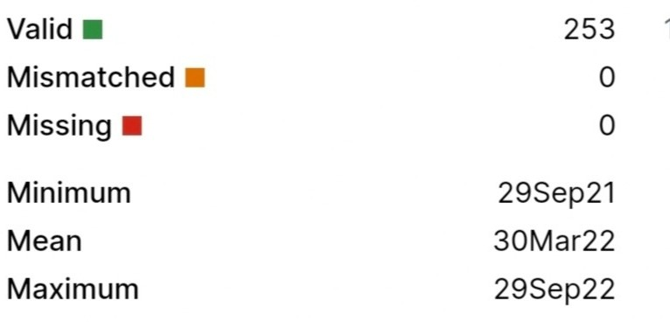
data set

Slide 9

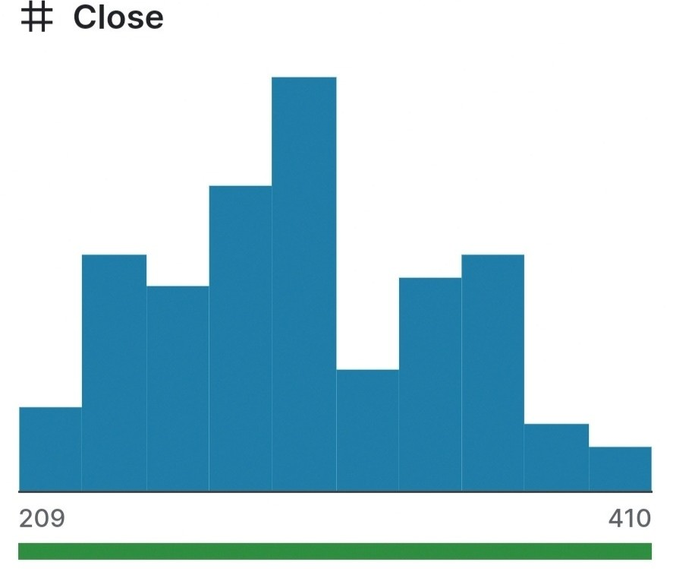
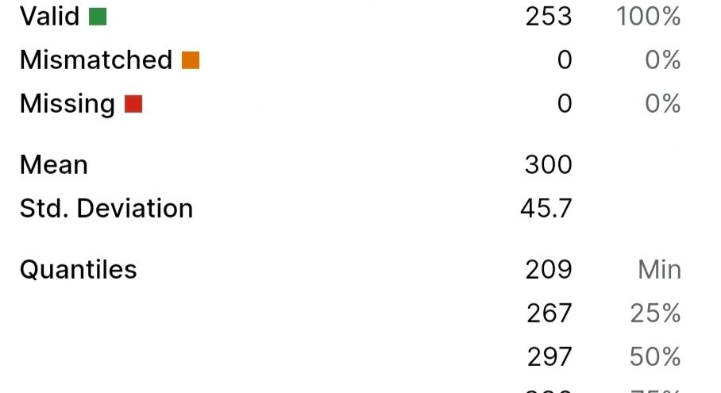

data set

Slide 10
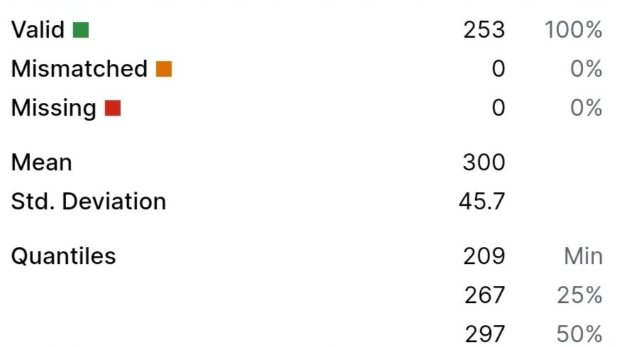
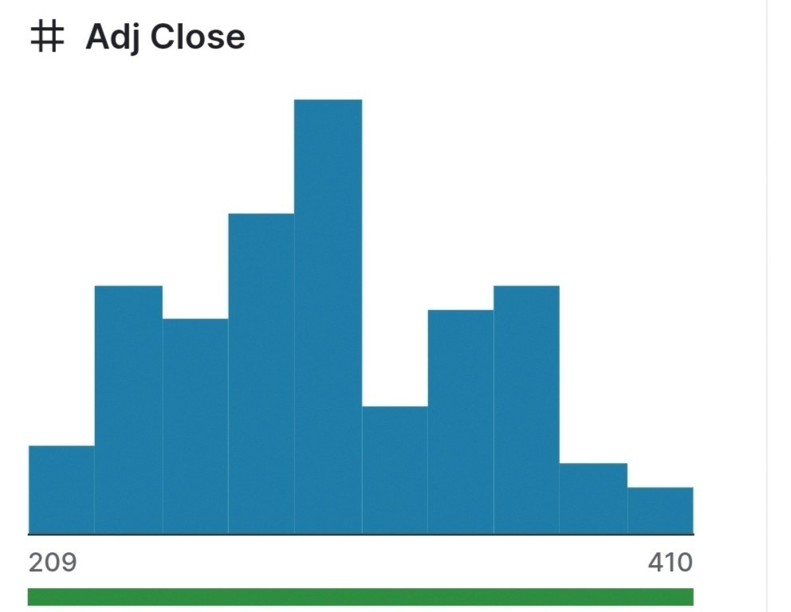



Slide 11
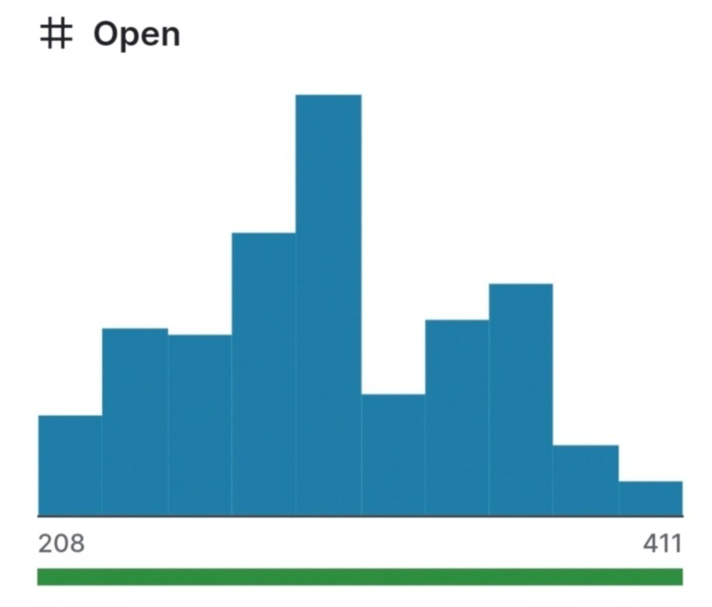
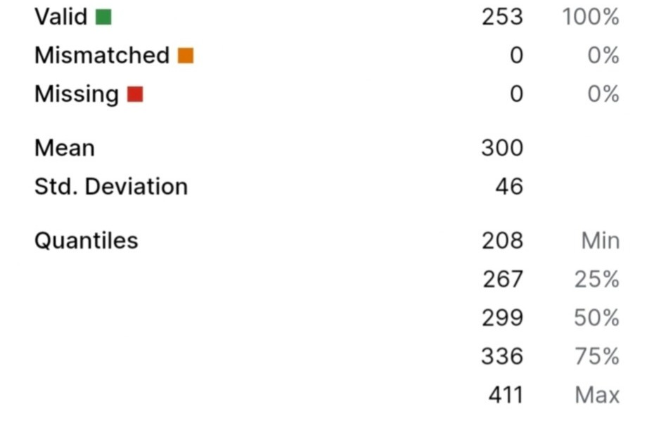

Slide 12
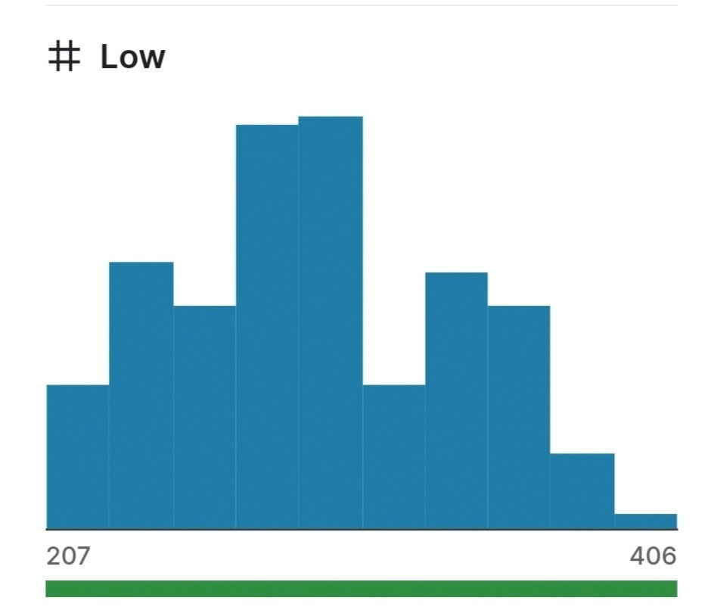
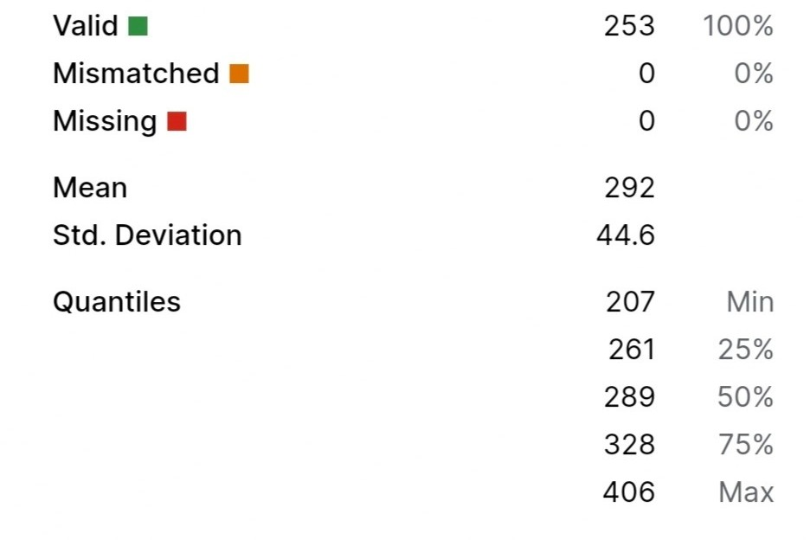


Slide 13
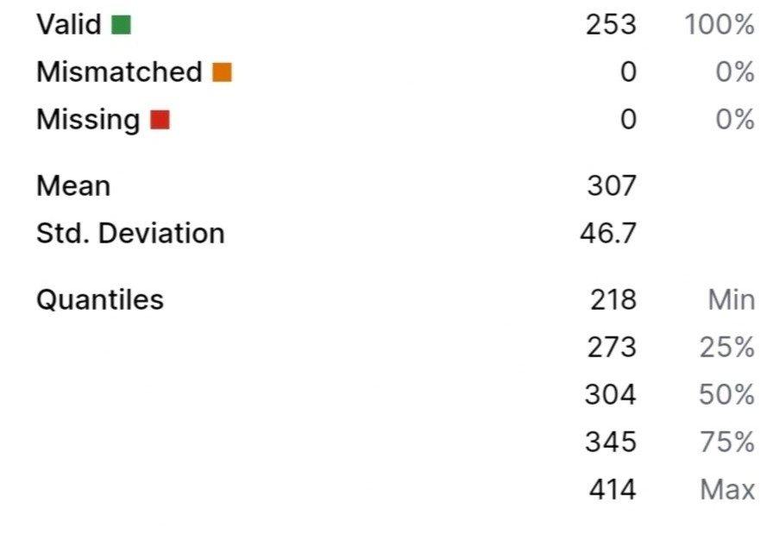
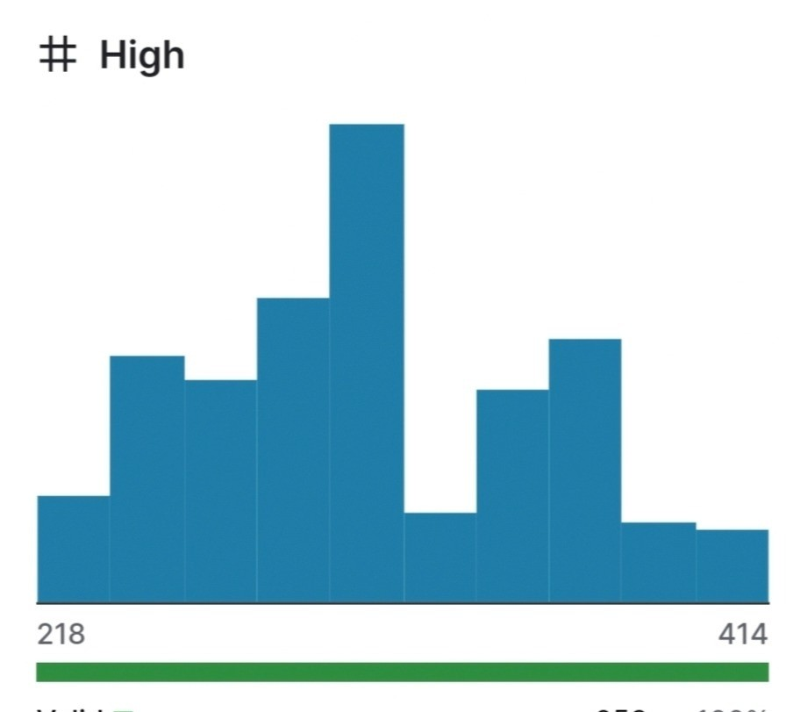


Slide 14
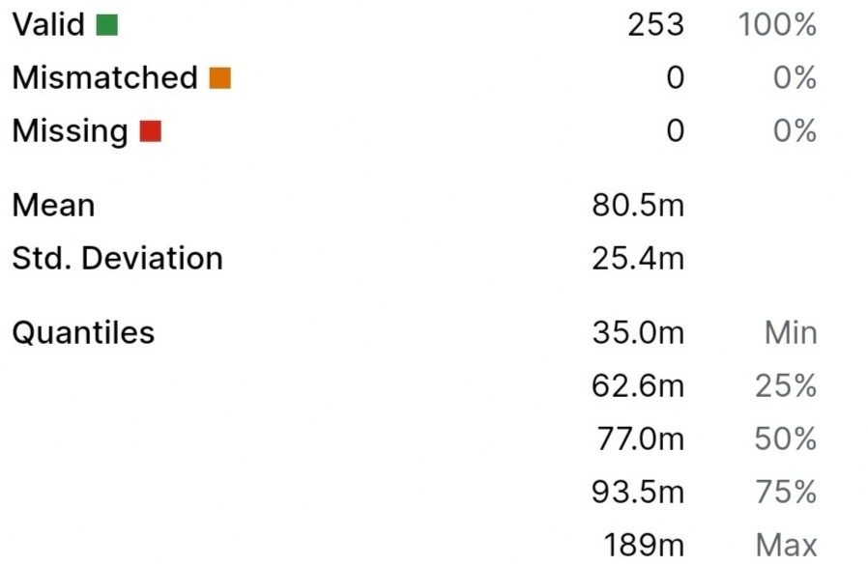
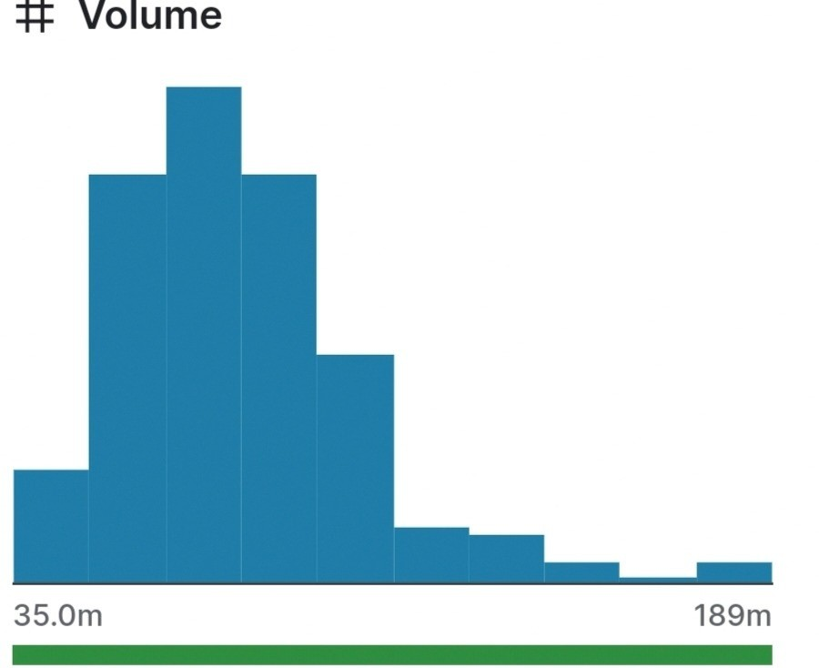

Slide 15
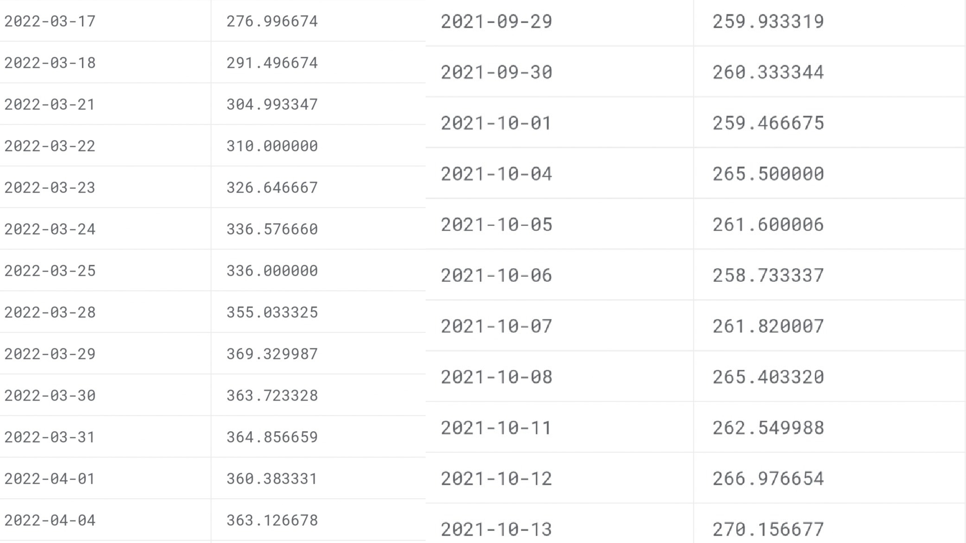

Slide 16
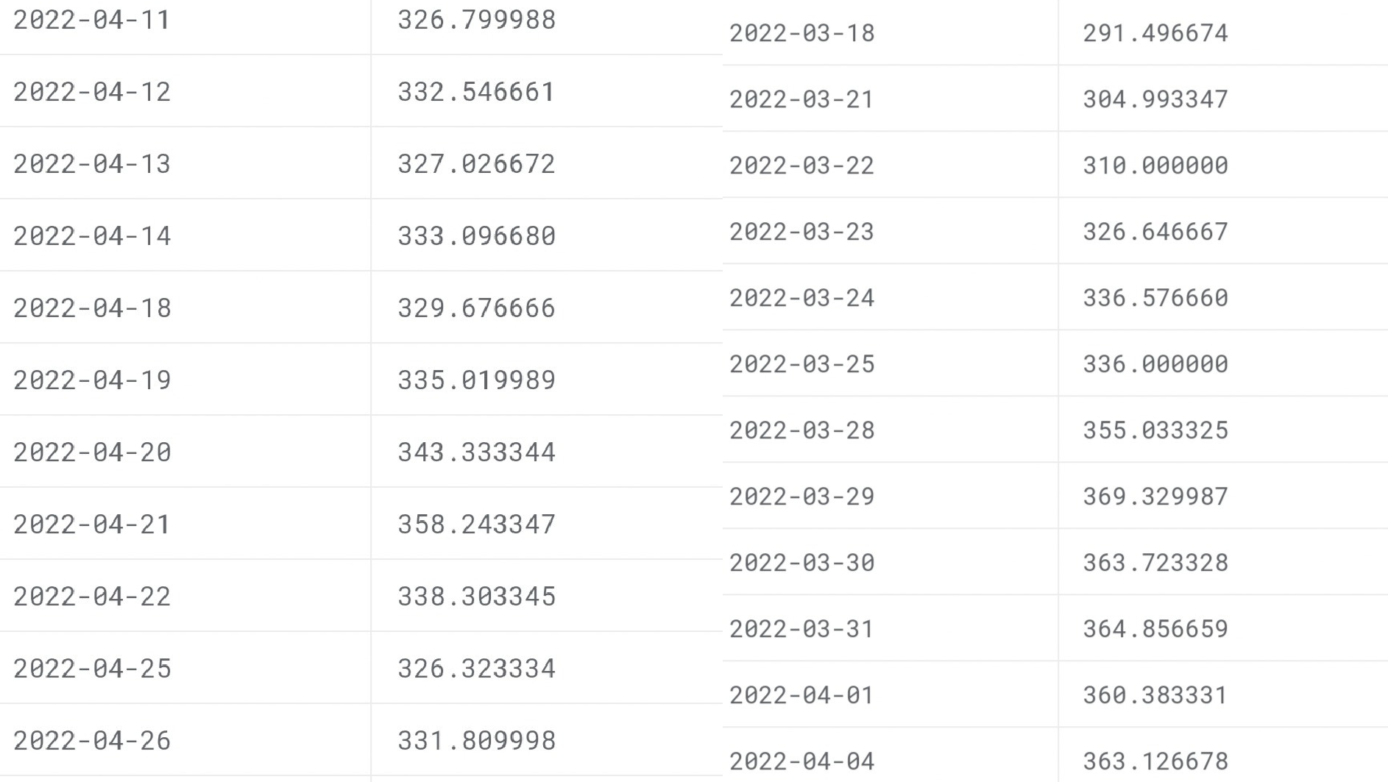

Slide 17
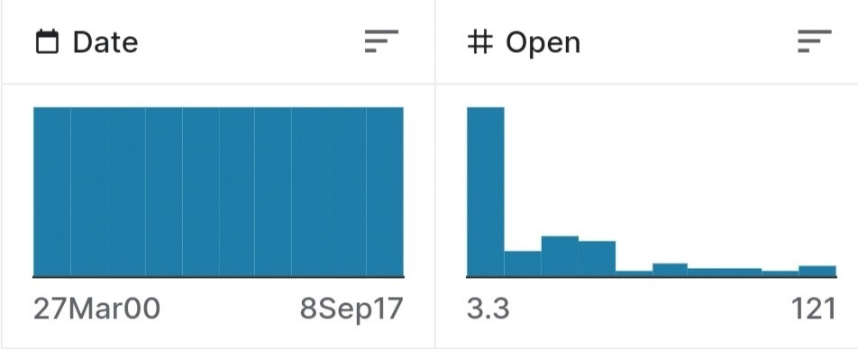

Slide 18
DATA PREPROCESSING STEPS
Data Cleaning:
Handle missing values: Identify and fill in missing data points or remove incomplete records.
Data Normalization/Scaling:
Normalize or scale the data to ensure that different features are on a similar scale. Common techniques include Min-Max scaling or Z-score standardization.
Feature Selection:
Select the most relevant features for your model. This might involve removing redundant or irrelevant features to reduce dimensionality.
Handling Time Series Data:
Address irregular time intervals: If the data has irregular time intervals, you may need to resample it to a consistent frequency.

Slide 19
Handling Categorical Data:
If your data includes categorical variables (e.g., stock symbols or market sectors), consider encoding them into numerical values (one-hot encoding or label encoding).
Feature Engineering:
Create new features that could help the model capture patterns, such as moving averages, exponential moving averages (EMAs), or technical indicators like Relative Strength Index (RSI) or Moving Average Convergence Divergence (MACD).
Volume-Related Features:
Incorporate trading volume data, as it can be informative for stock price prediction. You can create features like volume moving averages or volume relative to its historical average.
Sentiment Analysis:
If you have access to news or social media data, perform sentiment analysis to derive sentiment scores that can be used as features.
Handling Multi-Stock Data:
If you're working with multiple stocks, consider including features that capture interdependencies or sector-wide trends.

Slide 20
FEATURE EXTRATION TECHNIQUES
Wavelet Transform Features:
Wavelet transforms can help identify patterns at different time scales in time series data.
Principal Component Analysis (PCA):
Use PCA to reduce dimensionality and capture the most important features in a dataset.
Time-Domain and Frequency-Domain Features:
Analyze the time-domain features (e.g., mean, variance) and frequency- domain features (e.g., spectral entropy) of stock price data.
Market Breadth Indicators:
Create features that reflect the breadth of the market, such as the number of advancing and declining stocks in an index.
Autoencoder-Generated Features:
Train an autoencoder to create compressed representations of the data, which can serve as features.

Slide 21
ime-Based Features:
Day of the Week: Include the day of the week as a categorical feature, as stock market behavior can vary by day.
Month: Similar to days, the month can be a relevant factor in stock price behavior.
Fundamental Features:
Incorporate fundamental data, such as earnings reports, P/E ratios, or economic indicators that may impact stock prices.
Sentiment Analysis:
Use sentiment analysis on news articles or social media data to generate sentiment scores that can be used as features.
Correlation Features:
Calculate correlations between the target stock and relevant market indices or other stocks. High correlations can be indicative of sector-wide trends.
Lagged Features:
Include lagged features, such as the stock's own past prices or returns, to capture temporal dependencies.

Slide 22
MODAEL TRAINING
Validation:
Monitor the model's performance on the validation dataset during training. This helps you detect overfitting and assess how well the model is generalizing to unseen data.
Loss Function:
Define an appropriate loss function that quantifies the model's error in predicting stock prices. The choice of loss function depends on the specific task and model.
Regularization:
Apply regularization techniques (e.g., L1 or L2 regularization) to prevent overfitting, particularly for machine learning and deep learning models.
Early Stopping:
Implement early stopping based on the model's performance on the validation set to prevent overfitting and optimize training time.
Model Evaluation:
Evaluate the model's performance on the test dataset using appropriate metrics (e.g., Mean Absolute Error, Mean Squared Error, or financial metrics like Sharpe ratio, if applicable).

Slide 23
Backtesting and Strategy Development (if applicable):
If the goal is to assist investors in optimizing their strategies, develop and backtest trading strategies based on the model's forecasts.
Re-training and Maintenance:
Periodically retrain the model to adapt to changing market conditions. Stock price prediction models may require frequent retraining due to market volatility. Ensemble Models (optional):
Consider using ensemble techniques like bagging (e.g., Random Forests) or boosting (e.g., Gradient Boosting) to combine multiple models for improved accuracy.
Model Interpretation (optional):
If model interpretability is a concern, consider techniques like SHAP (SHapley Additive exPlanations) or feature importance analysis to understand the model's decision-making process.
Robustness Testing (optional):
Assess the model's robustness to outliers and unexpected market events by performing stress tests and sensitivity analyses.
Cross-Validation (optional):
Implement cross-validation techniques, such as k-fold cross-validation, to assess model stability and reduce the risk of overfitting.

Slide 24
EVALUATION METRICS
Mean Absolute Error (MAE):
MAE measures the average absolute difference between predicted and actual stock prices. It provides a simple and interpretable measure of the model's accuracy.
Formula: MAE = (1/n) * Σ|actual - predicted|
Mean Squared Error (MSE):
MSE measures the average squared difference between predicted and actual stock prices. It penalizes larger errors more heavily.
Formula: MSE = (1/n) * Σ(actual - predicted)^2
Root Mean Squared Error (RMSE):
RMSE is the square root of the MSE and provides an interpretable measure of the typical prediction error. It is in the same unit as the target variable.
Formula: RMSE = √(MSE)
Percentage Error Metrics:
Relative metrics like Mean Absolute Percentage Error (MAPE) and Mean Percentage Error (MPE) can provide insights into the model's predictive accuracy in percentage terms.
Formula (MAPE): MAPE = (1/n) * Σ(|(actual - predicted) / actual|) * 100

Slide 25
Information Coefficient (IC):
IC measures the correlation between predicted returns and actual returns. It's a common metric in quantitative finance.
IC = Correlation(predicted returns, actual returns) Calibration Metrics:
For probabilistic predictions, assess the calibration of the model using metrics like Brier Score, which measures the accuracy of predicted probabilities.Brier Score = (1/n) * Σ(predicted probability - actual outcome)^2
Profit and Loss Metrics (for trading strategies):
If the model is used for trading, evaluate it using metrics like cumulative returns, drawdown, and risk-adjusted returns.
Cumulative Returns: The cumulative profit or loss over time. Drawdown: The peak-to-trough decline in portfolio value.
Risk-Adjusted Returns: Metrics like the Sharpe ratio can be used to assess trading strategy performance.
F1-Score and Precision-Recall (for binary classification problems):
If you're predicting stock price movements (up or down), use metrics like F1-score, precision, and recall to evaluate the model's ability to classify correctly.
ROC-AUC (for binary classification problems):
ROC-AUC (Receiver Operating Characteristic - Area Under the Curve) measures the trade-off between the true positive rate and false positive rate. It's useful when evaluating binary classifiers.

Slide 26
CONCLUSTION
IT'S IMPORTANT TO CHOOSE EVALUATION METRICS THAT ARE RELEVANT TO YOUR PARTICULAR USE CASE AND TO CONSIDER THE TRADE-OFFS BETWEEN VARIOUS METRICS. ADDITIONALLY, IT'S COMMON TO USE A COMBINATION OF THESE METRICS TO GET A COMPREHENSIVE UNDERSTANDING OF YOUR MODEL'S PERFORMANCE. REMEMBER THAT THE CHOICE OF EVALUATION METRIC SHOULD ALIGN WITH THE SPECIFIC GOALS AND CONSTRAINTS OF YOUR STOCK PRICE PREDICTION PROJECT.

Slide 27
THANK YOU

